Slide 1


A Presentation on
Rule-Based Parallel Query Optimization for OQL Using a Parallelism Extraction Technique
Under Guidance of –
Prof. Uma S.
By –
Nitin Singh
17BCS019

Slide 2
INTRODUCTION
Some of the challenges involved in engineering a query optimizer for a parallel OODBMS relate to providing answers to the following issues
Which extensions to conventional (non-parallel) query processing steps are needed
Which features of the parallel architecture can be exploited during optimization
Which implementation approaches can be employed in the design of the parallel query optimizer
How to build a parallel optimizer that can be easily adapted to work with different parallel architectures

Slide 3
Our approach departs from a conventional (non-parallel) rule-based query optimizer and employs a parallelism extraction technique to unveil opportunities for independent parallelism and pipelined parallelism that can be exploited during query optimization for parallel OODBMS.
Ex. r1 ⋈ r2 ⋈ r3 ⋈ r4

Slide 4
Parallelism extraction Technique
It is based on analyzing the physical algebra generated by a non-parallel optimizer.
The aim of the analysis is to factorize the implementation code of the non-parallel algebraic operators in terms of more primitive operations defined by the algebraic execution engine of a target parallel DBMS physical algebra.
More primitive operations increase the chance of exploiting pipelined execution and the number of possible alternative parallel schedules that can be explored by the scheduler.

Slide 5
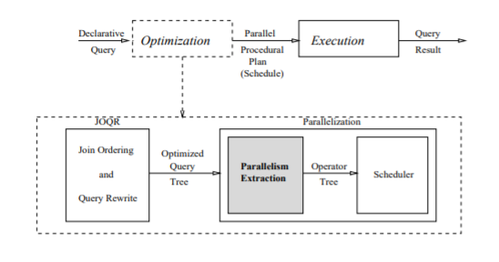
After the analysis and factoring of the non-parallel physical operators, the non-parallel optimizer is extended to incorporate rules that reflect the additions necessary to generate query plans for the parallel algebra

Slide 6
Object oriented data model
Elements of Object oriented data model
Objects :The real world entities and situations are represented as objects
Attributes and Method: Every object has certain characteristics. These are represented using Attributes. The behaviour of the objects is represented using Methods.
Class: Similar attributes and methods are grouped together using a
class
Inheritance: A new class can be derived from the original class. The derived class contains attributes and methods of the original class as well as its own.

Slide 7
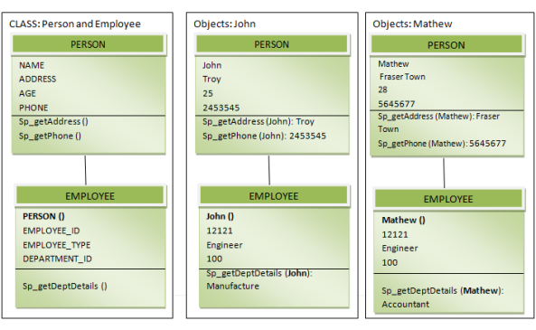

Slide 8
Object Query Language (OQL)
Object Query Language allows SQL-like queries to be performed on a OODB.
Like SQL, it is a declarative language. Based loosely on SQL, OQL includes additional language constructs which allow for object oriented design such as operation invocation and inheritance.
Query Structures look very similar in SQL and OQL but the results returned are different.

Slide 9
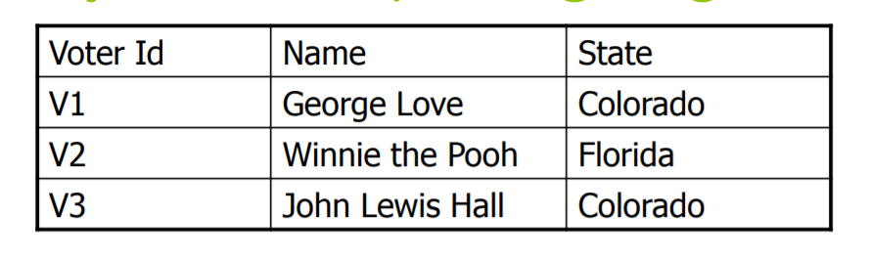
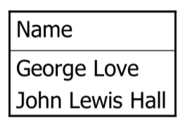
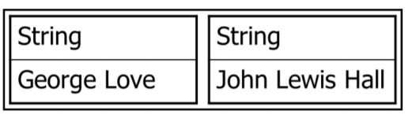
Example: OQL query to obtain Voter names who are from the state of Colorado
Select distinct v.name
From voters v
Where v.state = “Colorado”
Result from SQL
table with rows
Result from OQL
collection of objects

Slide 10
Incorporating Parallelism Into Query Optimization
A conventional (non-parallel) OO query optimizer generates a query execution plan (QEP) indicating the order of execution of operators and the algorithms chosen for computing each operation.
Such a plan can be abstracted as an annotated query tree, where each node represents an operator that is annotated with the method for computing the operation, and each edge represents the data flow between the operators.

Slide 11
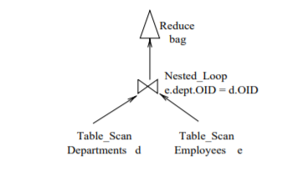
Example:
select struct(E: e.name, D: e.dept.name) from e in Employees;
QEP representation
Reduce, which is a generalization of the relational operator Project. It evaluates an expression like for every input element and converts the output to a bag, set or list, depending on the input parameters and the expected results
Nested loop, used for computing a Join operation
Table scan, which scans the extension of the class Employees and delivers the objects to the operator Nested loop.

Slide 12
The primary goal of applying parallelism extraction is to expose the opportunities for transforming QEPs in a way that takes advantage of an underlying parallel architecture.
The ultimate result is a QEP that preserves the original semantics of the query and also incorporates information regarding the available parallelism through annotations in the query trees.
The information regarding parallelism opportunities can be obtained by performing the following steps
1) identifying the atomic units of execution
2) identifying the timing constraints between the units

Slide 13
The atomic units represent the interface between the scheduler and the optimizer in the parallel query processor and define the set of new operators that will be used in the construction of parallel QEPs.
Set of atomic operators will compose a new physical algebra for the parallel architecture, created by the factoring of the code associated with the non-parallel physical algebra that implements the logical algebra operators.

Slide 14
factoring of code
Operator: Reduce(monoid,plan,variable,head,predicate)
monoid: the collection type that will be used to structure the output of an operation
plan: the input plan of an operation
variable: the variable that gets bound to objects
head: the projection expression to be evaluated for each input of the operation
predicate: a filter condition that selects the objects that will have the projection expression evaluated and stored in the output monoid.

Slide 15
Code Description:
1. Evaluation of the expression head for each tuple of the input stream of plan that satisfies predicate.
2. The operator reduces of the entire stream to a value (a stream of one value bound to variable) or a collection (a stream of tuples, where each tuple binds variable to the value of head), depending on the output monoid.
Factoring Result:
Evaluate head(plan,head,predicate) corresponding to step1 in
the code description.
Reducing(monoid,plan,variable,head) corresponding to step2 in the code
description.

Slide 16
Operator: Nested loop(left plan,right plan,predicate,keep)
Code Description:
1) Reading of the left plan (plan of smallest cardinality) into memory
2) Concatenation of the tuples in the input streams of the left and right plan
if they satisfy the predicate1. If keep=left, then it behaves like an left -
outer join (it concatenates the left tuple with null values) if keep=right ,it
behaves like a right-outer join, while if keep=none, it is a regular join.
Factoring Result:
1) Read(left plan) corresponding to step1 in the code description.
2) Match(left plan,right plan,predicate,keep) corresponding to step2 in the
code description.

Slide 17
Operator: Table scan(extent name,range variable,predicate)
Code Description
1) Creation of a stream of tuples, where each tuple has only one component
range variable, whose value is an object from the extent.
Factoring Result:
Table scan(extent name,range variable,predicate)
After splitting the operators, the next stage of parallelism extraction deals with the timing constraints between the components of the new physical algebra. Timing constraints between operators also limit the inter-operator parallelism and therefore affect the parallel optimization step

Slide 18
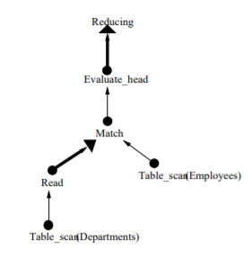
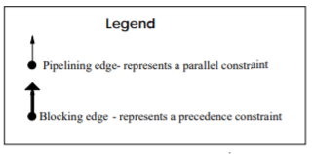
The following types of timing constraints can be identified between two units of execution
Parallel Constraints
Precedence Constraints
A parallel constraint between two physical operators requires both operators to start at the same time and terminate at the same time.
A precedence constraint requires one operator to start after the other one terminates.

Slide 19
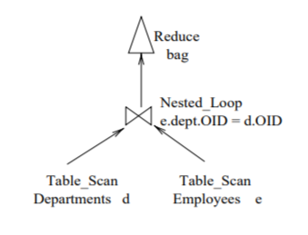
The timing constraints between two units of execution can be identified by the analysis of their behaviour (how they work) and relationship (if one of them passes data directly to the other) inside a QEP.
QEP before Parallel Extraction
Operator tree

Slide 20
Applying Parallelism Extraction
In this section we will provide examples of the application of the parallelism extraction technique using OPTGEN.
In order to obtain the units of execution for the parallel architecture, the sequential physical algebra code that implements the logical algebra operators are split into lower level atomic pieces that are relevant to the target architecture
After identifying the atomic units of execution (parallel physical algebra operators) by the factoring of the code , the logical algebra must be mapped to the new physical operators to allow the construction of operator trees.
This mapping is implemented using the OPTGEN rule language (OPTL), through the writing of physical rules.

Slide 21
Some of the physical rules written for this purpose are as follows:
{ order=order();}
reduce(‘M,‘e,‘v,‘head,‘pred)
= REDUCING(‘M,EVALUATE HEAD(‘e,‘head,‘pred),‘v,‘head)
{size = ˆe.size;
cost = ˆe.cost+ˆe.size;
order = ˆe.order; g;}
This rule translates a Reduce operation of the logical algebra into a Reducing (‘M,Evaluate head (‘e,‘head,‘pred),‘v,‘head) evaluation plan
size, cost and order are synthesized attributes, which form the physical properties of the produced plan.
The values for such attributes are computed when a rewrite is complete. The symbol ‘ is a escape operator, whose operand is expected to be an expression that provides the value to substitute the operand identifier.

Slide 22
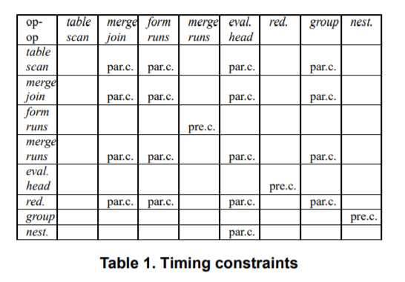
The timing constraints between the physical operators, identified by the analysis of the operators’ behaviour and relationships in a procedural plan, are presented in table 1.

Slide 23
The result of the application of the parallelism extraction technique in the query optimizer using OPTGEN is the production of QEPs that unveil information regarding the available parallelism, which was not represented in the sequential QEPs (before the application of the technique).
The QEPs resulting from parallelism extraction are ready to go through the scheduling step, in which resources are allocated to each operator of a QEP, taking into account the order and the timing constraints between the operators.

Slide 24
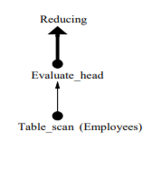
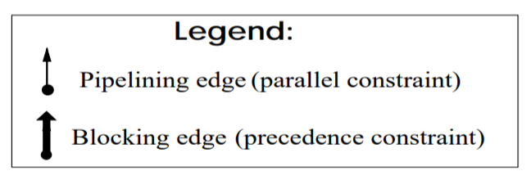
Example
Query 1: sum(select e.age from e in Employees);
REDUCING(sum, [PrC] EVALUATE HEAD( [PaC] TABLE SCAN(Employees,e,and()), project(e,age),and()), X 582,project(e,age))

Slide 25
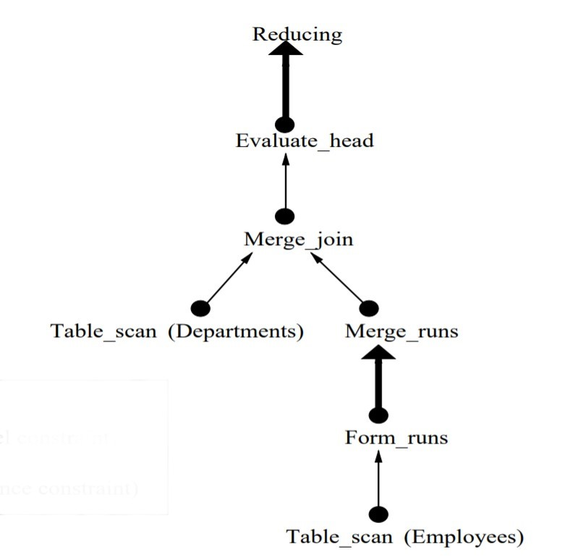
Query 2: select struct(E:e.name, D:e.dept.name) from e in Employees
REDUCING(bag, [PrC] EVALUATE HEAD( [PaC] MERGE JOIN([PaC] TABLE SCAN(Departments,X 524,and()), [PaC] MERGE RUNS([PrC] FORM RUNS( [PaC] TABLE SCAN(Employees,e,and()), order(OID(project(e,dept)))), order(OID(project(e,dept)))), and(eq(OID(project(e,dept)),OID(X 524))),right, order(OID(X 524)),order(OID(project(e,dept)))), struct(bind(E,project(e,name)),bind(D,project(X 524,name))),and()), X 482,struct(bind(E,project(e,name)),bind(D,project(X 524,name))))

Slide 26
Thank you

